Slide 1
Department of Automation Engineering
School of Electronics and Electrical Engineering, HUST
Notes:
Good morning, everyone, welcome to my presentation. My name is Nguyen Thai Nguyen. And today I would like to present about my graduation project.

Slide 2
Graduation thesis
AUTONOMOUS MOBILE ROBOT USING LIDAR SENSOR
Suppervisor: | Assoc. Prof. Nguyen Thi Lan Huong
Students: | Nguyen Thai Nguyen - 20192241
Notes:
The topic of my project is

Slide 3

Table of contents
1 – Introduction
2 – Hardware design
3 – Software design
4 – Result
5 – Conclusion and Develop direction.
Notes:
In this presentation, we have five main points include:

Slide 4
1. Introduction
Notes:
I would like to begin with introduction and ROS Overview

Slide 5
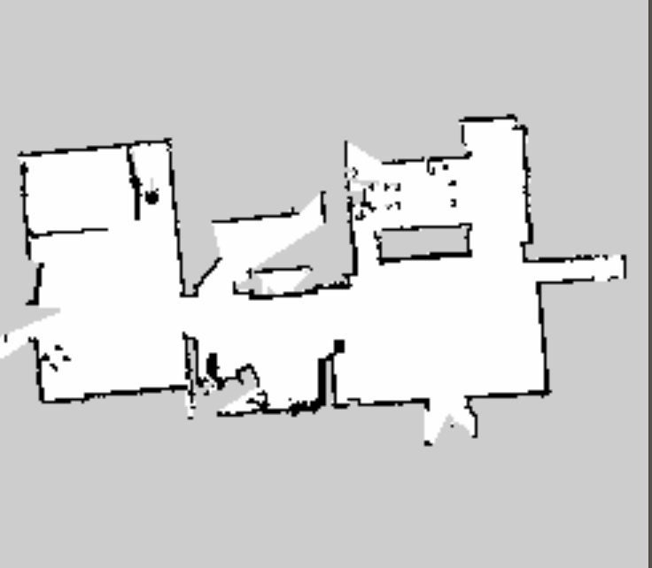
1.1 introduction - SLAM
Simultaneous
Localization
And
Mapping
Figures 1.1. Apply slam to build a map.
Notes:
about the introduction, we need to understand what slam is, because my project is one of many SLAM application. SLAM stands for…………. It is the process of mapping while keeping track of the robot location.

Slide 6
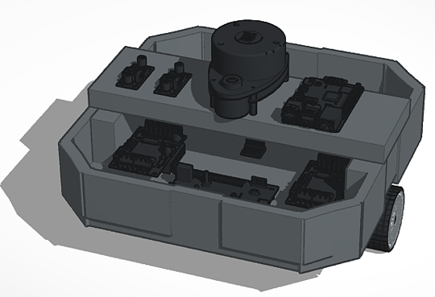
1.2 introduction – the goals of project
Figures 1.2. 3d robot model design.
Simulate and navigate robots on Gazebo and Rviz.
Robots are capable of building a map in unknown space.
Robot can find the shortest path to the destination.
In addition, during movement, the robot can avoid fixed obstacles and react appropriately to avoid moving obstacles.
Notes:
The n, I will talk about the Main aim of the project is to develop autonomous robots that can build a map and move to a destination without being stuck by obstacles. This mobile robot has extremely diverse and potential applications, however, this project mainly focuses on some main functions developed based on ROS that is: …………
And because, all the system is built based on ROS, so first of all we need to introduce about ROS.

Slide 7
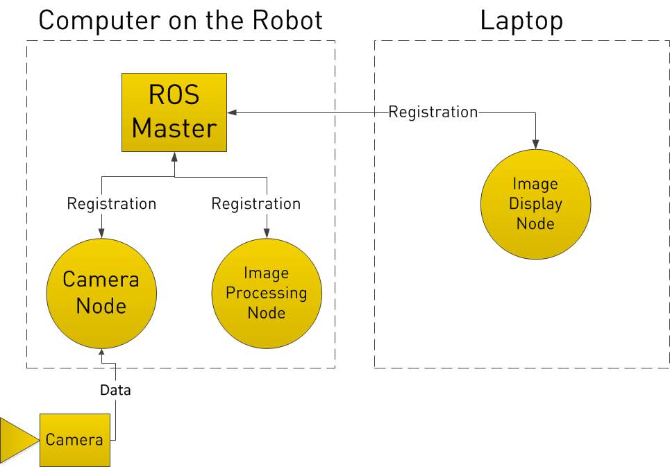
1.3 Robot operating system (ROS)
ROS definition: The Robot Operating System (ROS) is an open-source framework.
Why ROS was chosen in this system:
Ros can be divided into open-source packages that can be downloaded and reuse.
Nodes in ROS do not have to be on the same system.
How ROS work: a ROS system can be divided into nodes and each node must register with ROS master to communicate with other nodes
Notes:
What is ROS: The Robot Operating System (ROS) is an open-source framework that helps researchers and developers build and reuse code between robotics applications.
How ROS work: ……… You can see the example the system is divided into three node include camera node, image processing node, and image display nodes; they communicate together through ROS master.
Why ROS was chosen in this system:
ROS can be divided into open-source packages that can be downloaded and reuse.
Nodes in ROS do not have to be on the same system. You can see the figure: we can use laptop to display, while computer on the robot control the system.

Slide 8
1.4 introduction- system overview
Costmap
Hector_Slam
System
SLAM
Navigation
Dijkstra
Scan_matching
DWA
Particle filter
AMCL
Notes:
obstacle area, possible collision area, and a robot movable
Adaptive monter carlo localization.

Slide 9
2. Hardware design
Notes:
After introduce about project and ROS overview, I will go detail about the system: , so now, I will talk about hardware design.

Slide 10
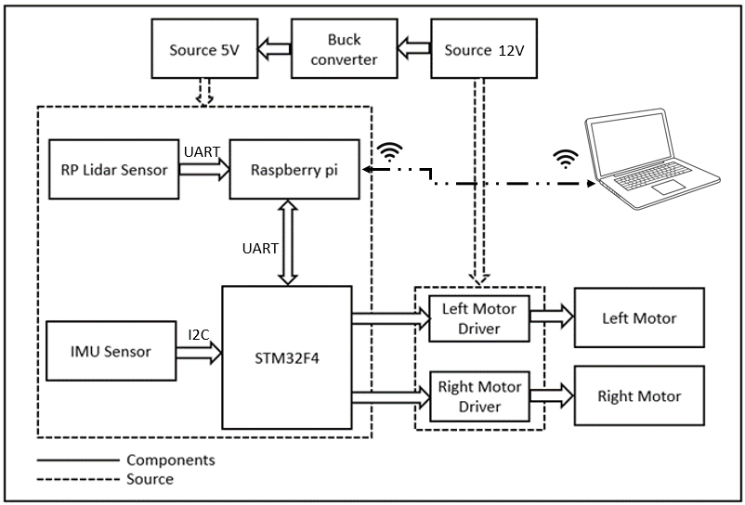
2.1 Hardware design-block diagram
The function of main blocks:
Source: include 5V supply for raspberry pi, sensor,stm32f4 and 12V block supply for motors.
Sensors: include Lidar sensor supply the distance of obstacles around robot, and the IMU senso help determine the angle and direction of robot
Computers: Raspberry pi as intermediary processor between laptop and robot. laptop is used to control and monitor the robot
Stm32f4 is used to control the robot speed, and continuously calculate the odometry from the IMU, and the number of pulses of the stepper motor, then send it back to the raspberry pi
Figure 2.1. block diagram.
Notes:
Here you can see block diagram, and to understand that, I will explain detail about the functions of main blocks:

Slide 11
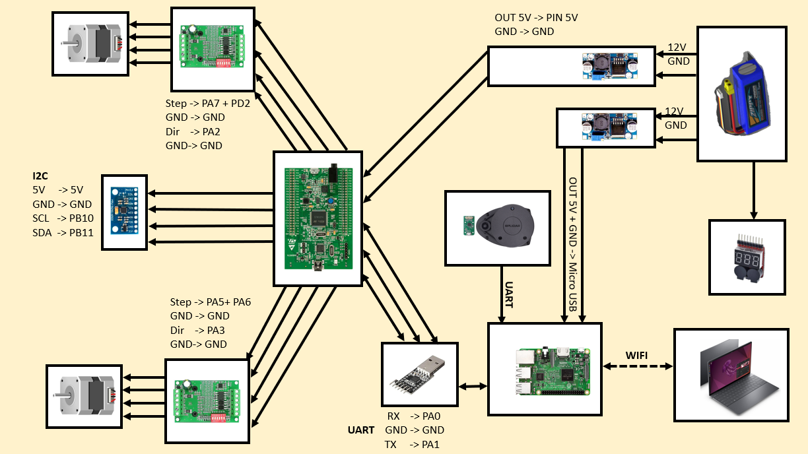
2.2 Hardware design – wiring diagram
Figure 2.1. wiring diagram.
The connection:
MPU9250 ~ STM32f4: I2C protocol
Rplidar A1~ Raspberry pi: UART protocol
STM32f4 ~ Raspberry pi: UART protocol
Raspberry pi ~ Laptop: Wi-Fi network
Notes:
Here is wiring diagram of robot:
The connect method of each component together is that:

Slide 12
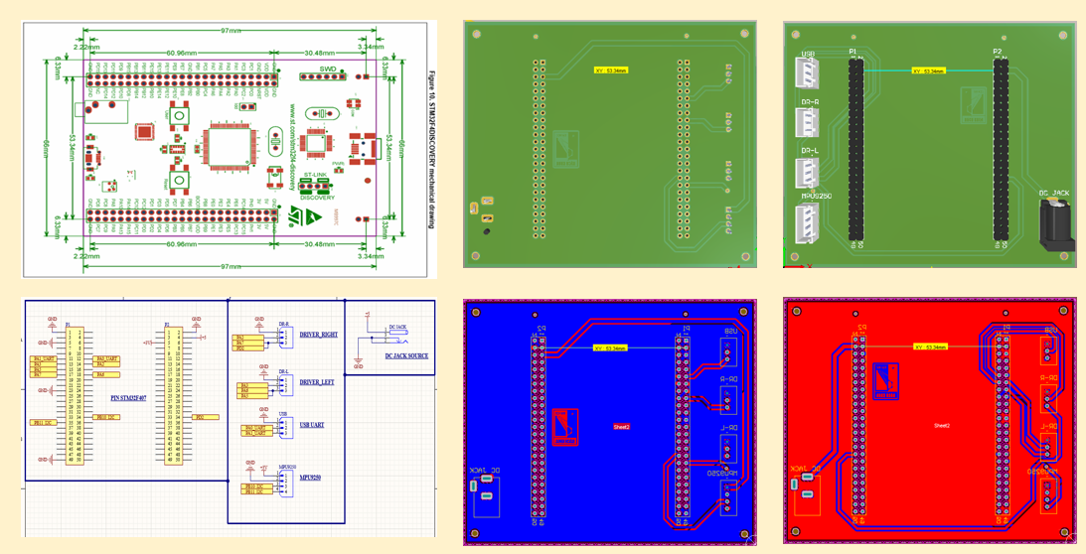
2.3 hardware design- PCB design.
Figure 3.1. PCB design in Altium.
Notes:
Here is PCB design, The design of the circuit board not only optimizes space but also minimizes the error rate that comes from manual connections but also helps limit problems that may arise during robot operation.
The size of the PCB circuit board is designed to match the size of the components according to the manufacturer's specifications.

Slide 13
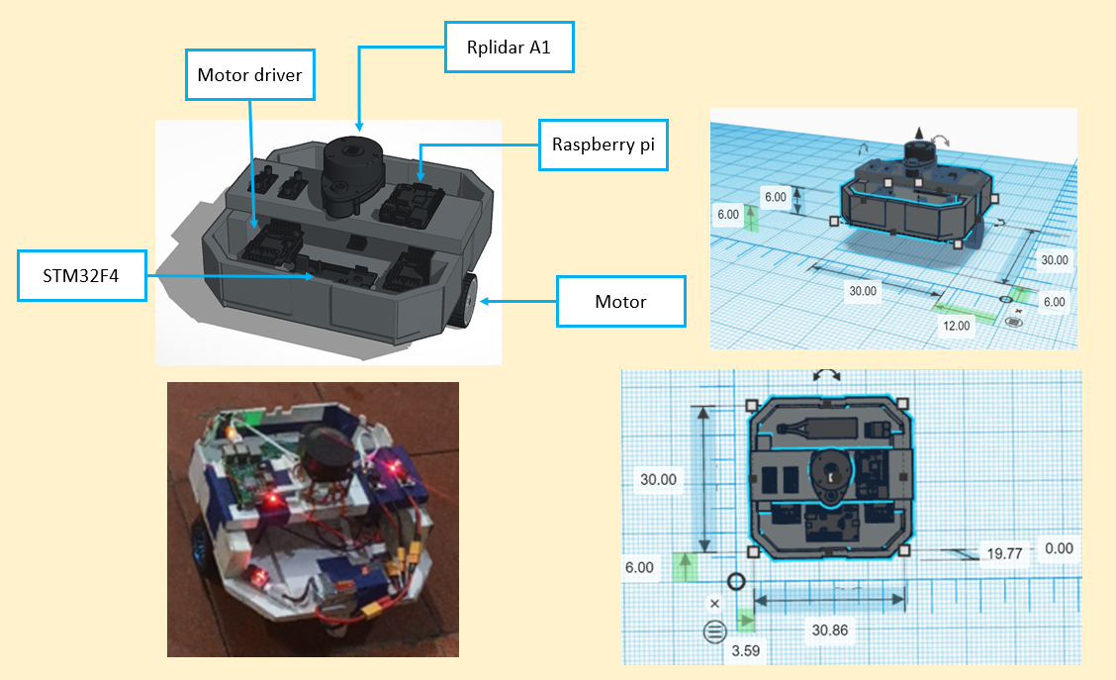
2.4 Hardware design – frame robot
Main components:
Stm32F4, Raspberry pi, Rplidar A1, Motors.
Robot dimensions:
features | value
Diameter | 300 mm
Robot height | 198 mm
wheel distance | 280 mm
wheel diameter | 65 mm
Notes:
Here is the structure of the robot's frame
designed so that the components are arranged roughly and combined, properly sized,
and designed according to the differential-drive model.

Slide 14
3. Software design
Notes:
Next we will go to the software system

Slide 15
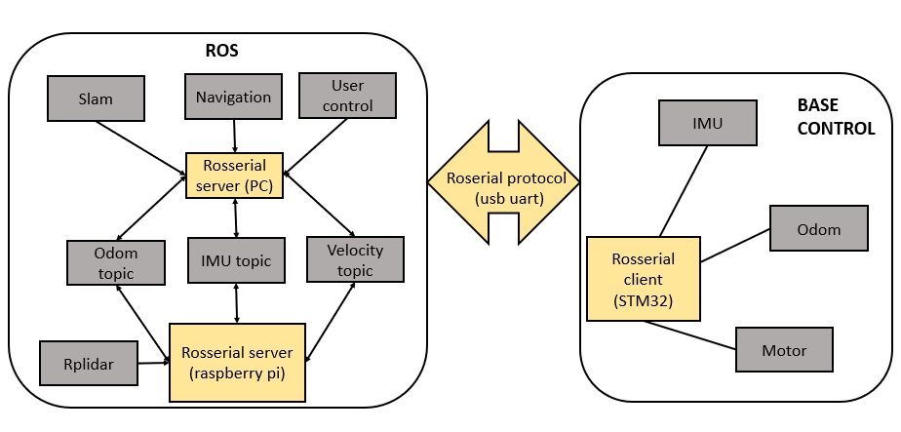
3.1 Software design
Figure 3.1. software structure of all system.

Slide 16
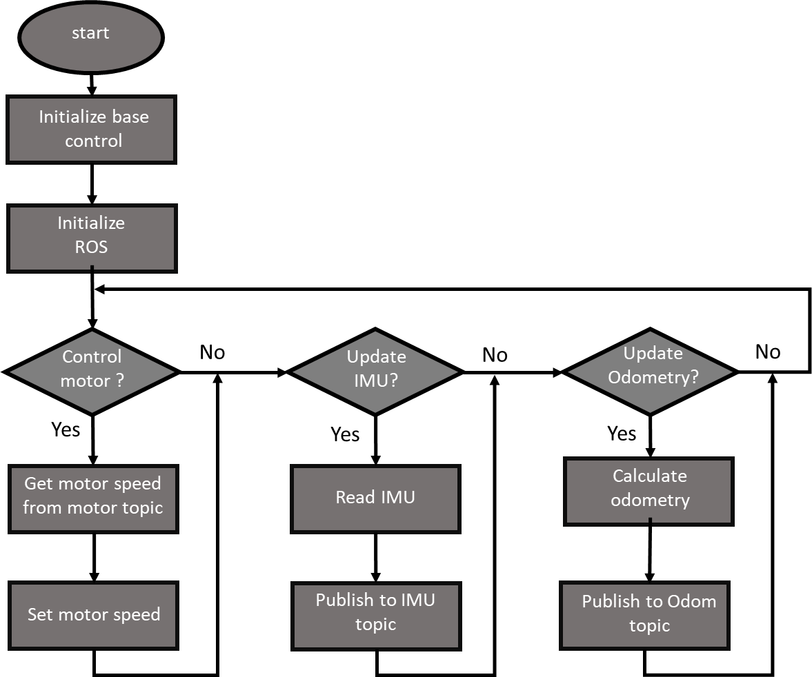
3.2 software design - flowchart
Figure 3.2. flowchart of base_control.
Notes:
The system is divided into two main parts:
The first part is software on laptops and raspberries because we use ROS so these programs can be downloaded and used.
The second part is the program on STM32, this is the program flowchart in STM32.
First, when starting up, we need to initialize base control and initialize ROS, then we need to execute the statements in the loop.

Slide 17
4. Result.
Notes:
After the system has been completed, we will go into testing and get the results, next is chapter 4 the results.

Slide 18
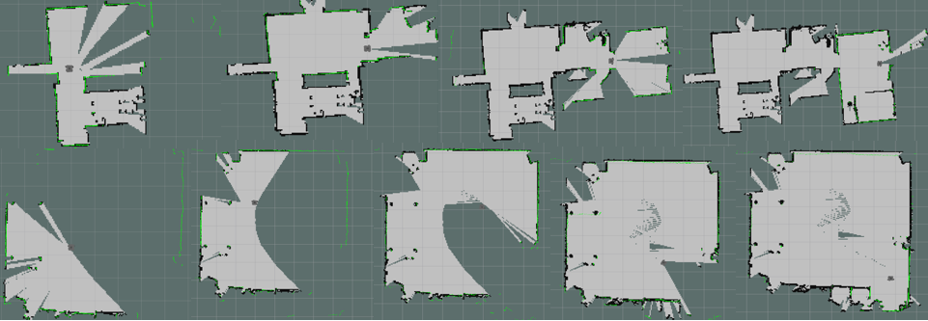
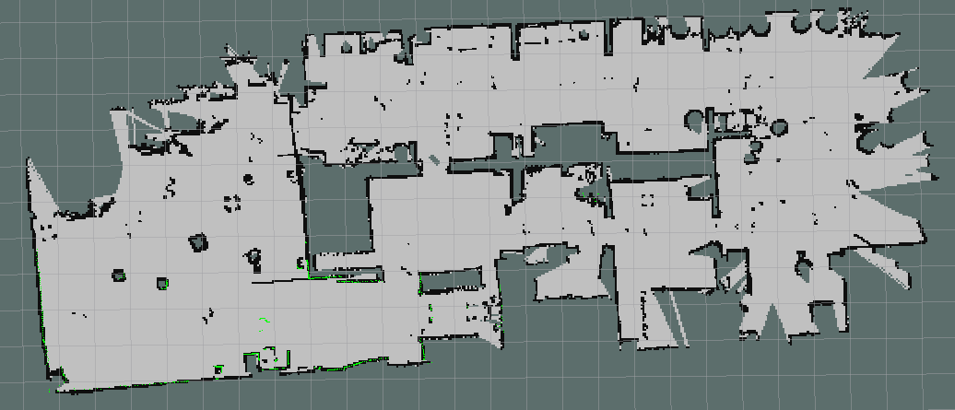
4.1 result – build map
Figure 4.1. the process build map.
Notes:
First we will let the robot build an environment map, and check the accuracy of the map

Slide 19
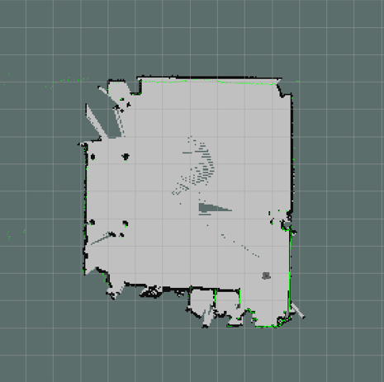
4.1 result – Evaluate the built map.
x
 | Reality (m) | SLAM (m) | error (m)
x | 7.63 | 7.57 | 0.06
y | 8.87 | 9.00 | 0.13
y
Figure 4.2. the process build map in a large yard.
Notes:
After constructing the map, we obtain the results and compare them with the actual map size

Slide 20
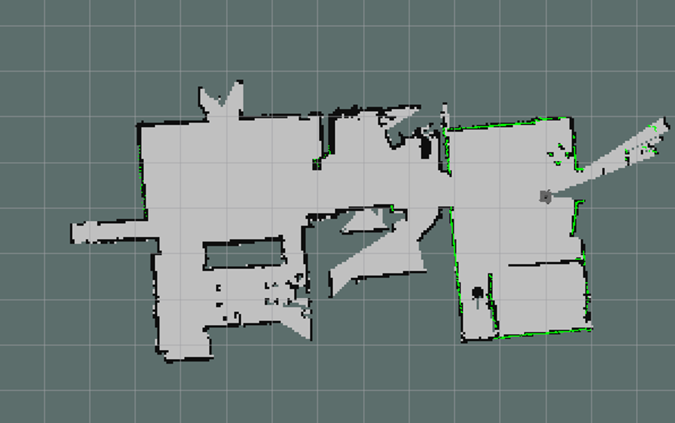
4.1 Result – Evaluate the built map.
e
 | Reality (m) | SLAM (m) | error (m)
a | 5.24 | 5.30 | 0.06
b | 3.42 | 3.50 | 0.08
c | 3.20 | 3.25 | 0.05
d | 2.96 | 2.87 | 0.09
e | 9.72 | 9.50 | 0.12
a
c
d
b
Figure 4.3. the process build map in home.
Evaluate: The map is built with dimensions close to reality with an error of no more than 0.13m
Notes:
After constructing the map, we obtain the results and compare them with the actual map size

Slide 21
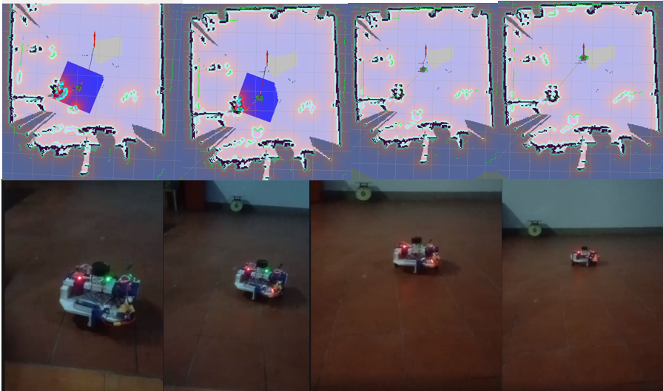
4.2 Result – Navigation.
Figure 4.4. Robot go to the destination.
Notes:
After building the map, we will let the robot perform the positioning function and go to the destination on the map

Slide 22
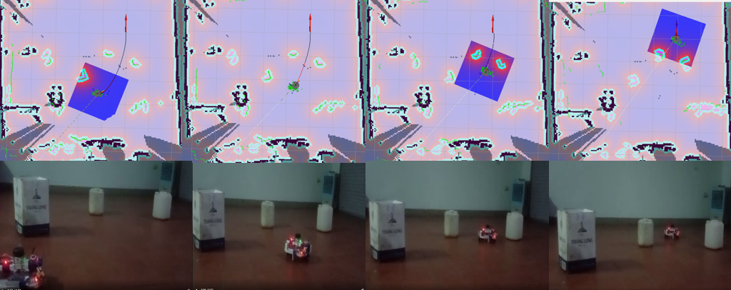
4.2 Result – Navigation.
Figure 4.5. the process build map.
Notes:
Here we let the robot move to the destination on a map containing fixed obstacles

Slide 23
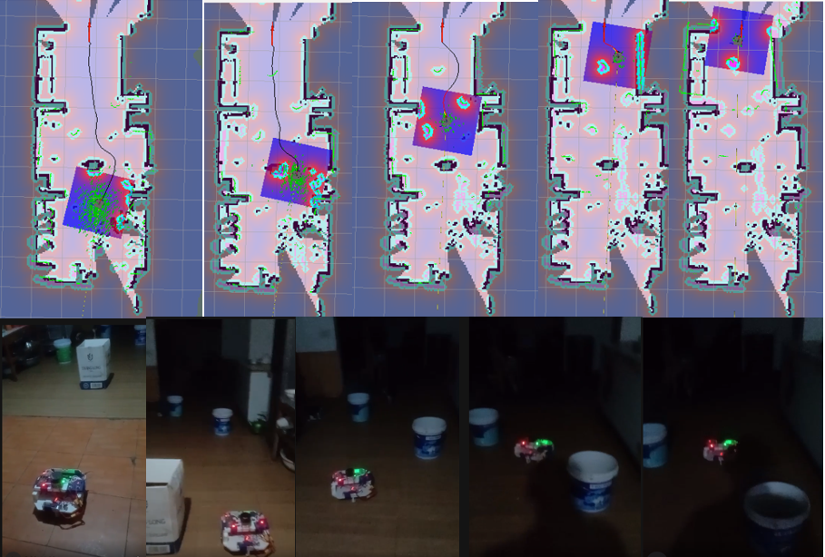
4.2 Result – Navigation.
Evaluate: The robot was able to reach its destination, avoiding fixed and newly appearing obstacles relatively accurately. However, when moving on slippery surfaces, when it reached the end of the path, the robot still had difficulty moving. find destination
Figure 4.6. robot go to the destination with new obstacles appear.
Notes:
Here we let the robot move to the destination in a longer path with fixed obstacles, and new obstacles appear on the way.

Slide 24
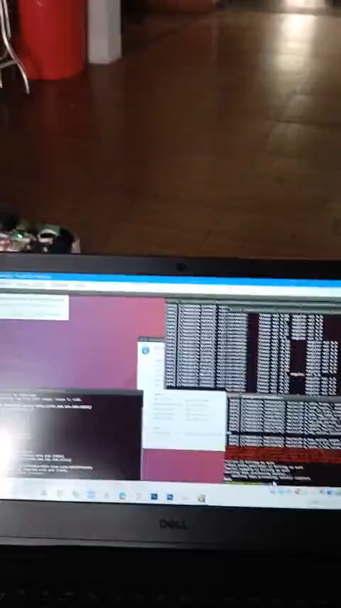
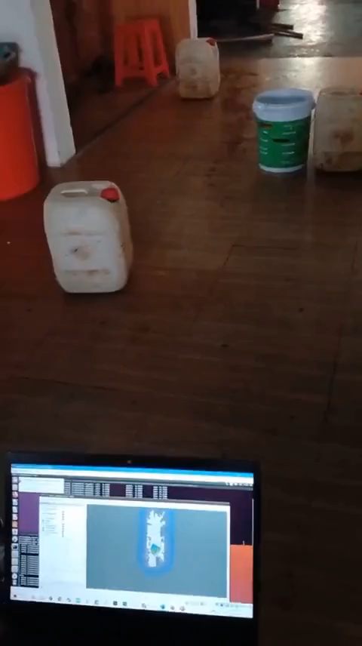
4.3 Result – video demo
video1.video demo build map.
video1. video demo navigation.
Notes:
This is a video recording the map building process

Slide 25
5. Conclusion and development direction.
Notes:
After performing the proposed tasks and achieving the above results, we will come to a conclusion and development direction of the project.

Slide 26
5.1 Conclusion
Achieved:
The robot's information gathering and mapping process is quite accurate compared to reality.
During movement, the robot's ability to avoid obstacles is quite accurate. When encountering static or moving obstacles, the robot can react appropriately to avoid those obstacles.
Restrict:
Robots cannot avoid obstacles lower than LIDAR
Does not work well on slippery surfaces.
Notes:
First, the project's achievements are:
The robot's information gathering and mapping process is quite accurate compared to reality.
During movement, the robot's ability to avoid obstacles is quite accurate. When encountering static or moving obstacles, the robot can react appropriately to avoid those obstacles.
Finally, there are limitations of the system:
Robots cannot avoid obstacles lower than LIDAR

Slide 27
5.2 Development direction.
To perfect an optimal robot that operates well and stably in many different environmental conditions, from there commercializing the robot model requires further development:
Improve the hardware design to be sturdy, beautiful, and resistant so that the robot can transport goods and supplies to users.
Integrate an additional camera to be able to receive electricity from objects and the surrounding environment.
Integrate other functions to perform functions such as robot vacuum cleaners and delivery robots.
Notes:
and The development direction of the system is:

Slide 28
THANK YOU !
Notes:
That's my entire presentation, thank you for listening

Slide 29
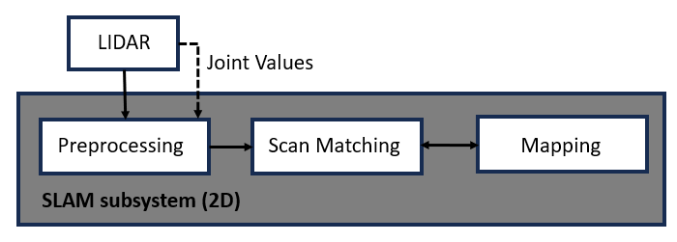
Appendix- Hector slam
Figure 1. Map building process.
Step 1: The LIDAR sensor will scan the surrounding environment.
Step 2: The preprocessing process will use the Hector SLAM algorithm
Step 3: The Scan Matching process will optimize the alignment of drawn points and newly scanned points
Step 4: Let the robot move around and complete the map.
Notes:
Step 1: The LIDAR sensor will scan the surrounding environment. The value returned from the sensor includes 360 points corresponding to 360 degrees when the sensor scans the surrounding environment. Each point will have a distance value calculated from the LIDAR to the location of the obstacle.
Step 2: The preprocessing process will use the Hector SLAM algorithm to interpolate all the above points into corresponding values on the map and plot them on thegrid map
Step 3: The Scan Matching process will optimize the alignment of drawn points and newly scanned points so that the occupancy value is minimized
Step 4: Perform LIDAR migration based on the calculation of the above processes, we will obtain a map of the environment to be scanned.

Slide 30
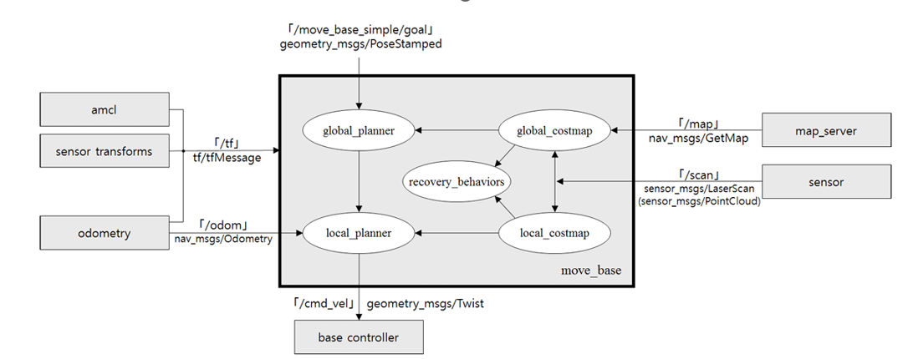
Appendix- Navigation
Figure 2. Relationship between essential nodes and topics on the navigation packages configuration.
Notes:
The idea of Navigation Stack is quite simple, it is a program that takes information from odometry (estimated coordinates) and sensors, processes and outputs commands in the form of velocity to the mobile model.

Slide 31
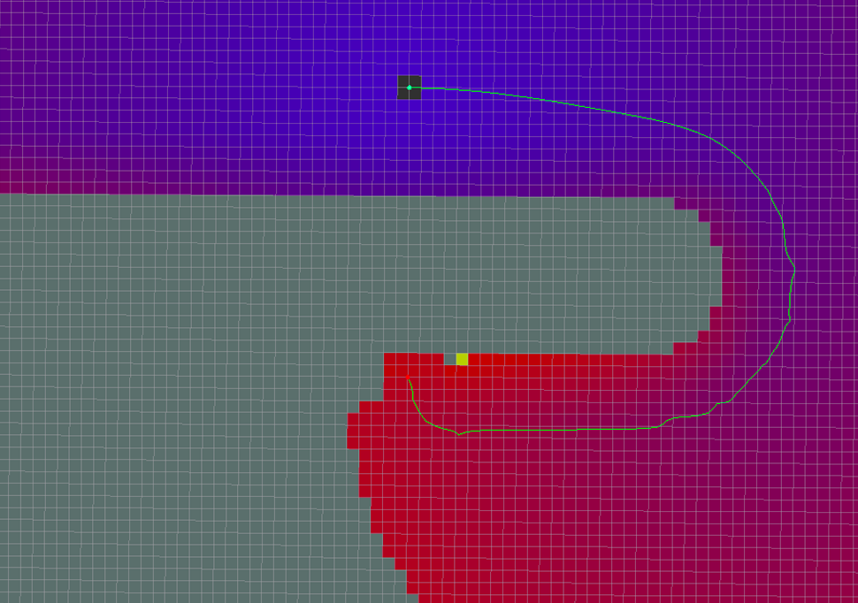
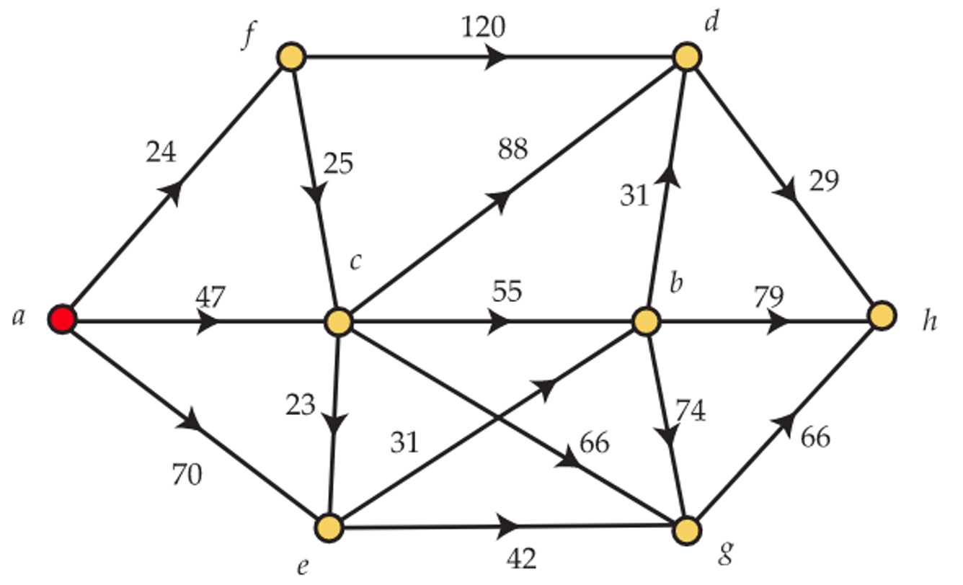
Appendix- Dijkstra algorithm.
Figure 3. Path planning using Dijkstra's algorithm.
Figure 4. Dijkstra Algorithm.
Notes:
Dijkstra's algorithm is a route finding algorithm that generates every route through the graph, then chooses the route with the lowest total cost. This works by iteratively calculating the distance for each node in the graph, starting at the start node and continuing until we get to the end node
it is used to find the shortest path from the initial position to the robot's destination.

Slide 32
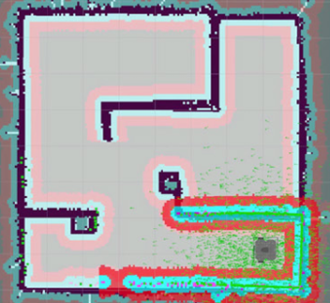
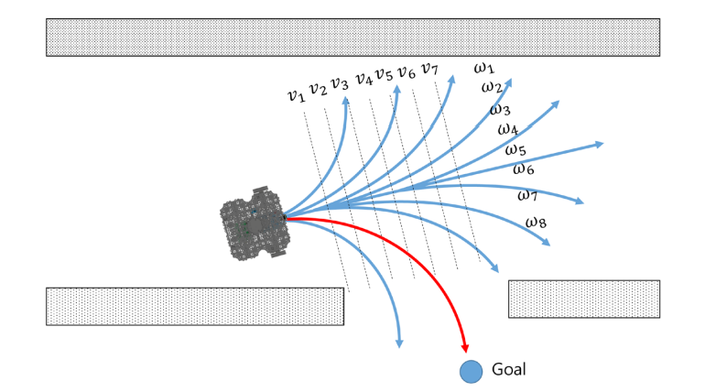
Appendix- AMCL Algorithm and DWA Algorithm.
Figure 5. AMCL process for robot pose estimation
Figure 6. DWA algorithm.
Notes:
The AMCL algorithm works by representing the robot's pose as a distribution of particles, where each particle represents a possible pose of the robot

